Slide 1




DATA ANALYTICS
PROJECT
B2B AUTOMOBILE PARTS SALES &
CUSTOMER ANALYTICS DASHBOARD
COMPREHENSIVE DATA-DRIVEN INSIGHTS FOR SALES PERFORMANCE AND CUSTOMER BEHAVIOR ANALYSIS.
2024

Slide 2


DATA ANALYTICS
DASHBOARD
PROJECT OVERVIEW
ANALYZE B2B AUTOMOBILE PARTS SALES DATA TO UNCOVER REVENUE TRENDS AND GROWTH OPPORTUNITIES.
DEVELOP INTERACTIVE POWER BI DASHBOARDS FOR SALES, CUSTOMER BEHAVIOR, AND EMPLOYEE PERFORMANCE INSIGHTS.
EMPOWER STAKEHOLDERS WITH DATA-DRIVEN DECISION-MAKING TOOLS FOR STRATEGIC PLANNING.

Slide 3


B2B AUTO PARTS
ANALYTICS
PROBLEM STATEMENT
DATA SILOS ACROSS DEPARTMENTS LIMITING CROSS-FUNCTIONAL ANALYSIS.
LACK OF REAL-TIME VISIBILITY INTO SALES PERFORMANCE AND CUSTOMER BEHAVIOR.
MANUAL REPORTING PROCESSES CAUSING DELAYS AND INEFFICIENCIES.

Slide 4


B2B AUTO
ANALYTICS
PROJECT OBJECTIVES
CENTRALIZE B2B AUTOMOBILE PARTS SALES DATA INTO A UNIFIED ANALYTICS PLATFORM.
ENABLE REAL-TIME INSIGHTS THROUGH INTERACTIVE DASHBOARDS AND KPI TRACKING.
IMPROVE STRATEGIC DECISION-MAKING WITH DATA-DRIVEN CUSTOMER AND SALES ANALYTICS.

Slide 5


DATA CLEANING & ETL
SOURCE EXTRACTION FROM MULTIPLE B2B SALES DATABASES, CRM SYSTEMS, AND INVENTORY RECORDS.
TRANSFORMATION RULES APPLIED: STANDARDIZING DATE FORMATS, NORMALIZING PRODUCT CODES, AND AGGREGATING REGIONAL DATA.
QUALITY CHECKS IMPLEMENTED: DUPLICATE REMOVAL, NULL VALUE HANDLING, AND DATA VALIDATION PROTOCOLS.

Slide 6


DATA MODEL
STAR SCHEMA ARCHITECTURE WITH CENTRALIZED FACT TABLE FOR SALES TRANSACTIONS.
DIMENSION TABLES: CUSTOMERS, PRODUCTS, EMPLOYEES, TIME, AND GEOGRAPHY.
RELATIONSHIPS ESTABLISHED VIA PRIMARY AND FOREIGN KEYS FOR OPTIMIZED QUERIES.

Slide 7


KPI METRICS
TOTAL REVENUE :
$2.4M
CUSTOMER COUNT :
1,847
CHURN RATE: 12.3% - BELOW INDUSTRY AVERAGE, INDICATING STRONG CUSTOMER RETENTION.
AVERAGE ORDER VALUE: $1,298 - CONSISTENT B2B PURCHASING PATTERNS.

Slide 8

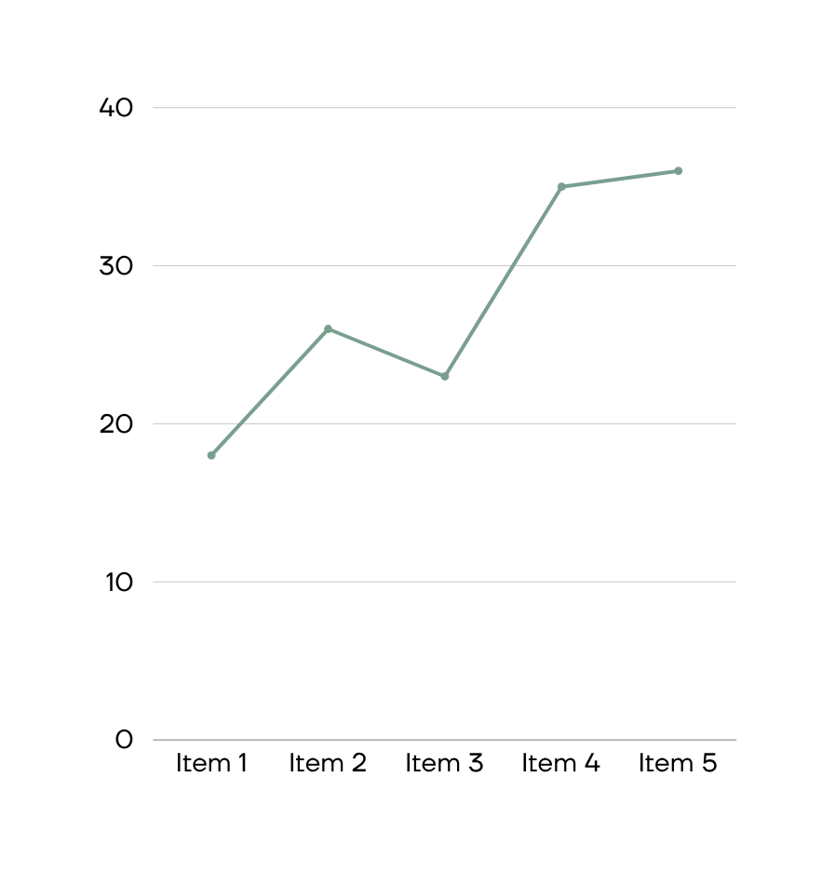
SALES DASHBOARD
$4,250,000
TOTAL REVENUE SHOWS STRONG QUARTERLY GROWTH WITH 23% INCREASE YOY.
TOP REGIONS: NORTH AMERICA, EUROPE, AND ASIA PACIFIC DRIVING 78% OF TOTAL SALES.

Slide 9

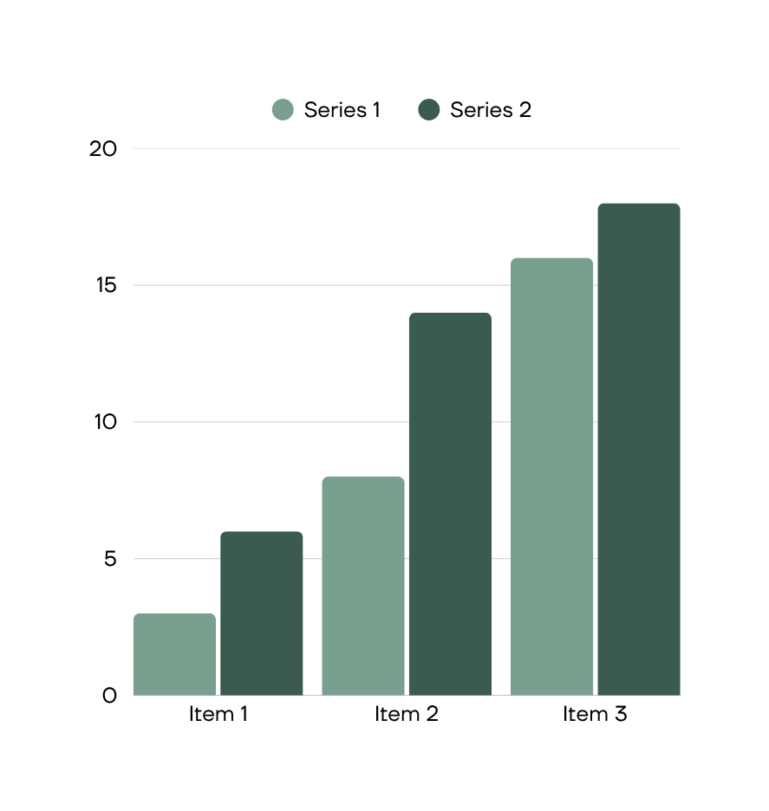
CUSTOMER BEHAVIOUR DASHBOARD
2,847 ACTIVE CUSTOMERS
FREQUENT BUYERS: 423 CUSTOMERS WITH 5+ ORDERS ANNUALLY, CONTRIBUTING 67% OF TOTAL REVENUE.
CHURN RATE: 12.3% YEAR-OVER-YEAR, DOWN FROM 18.1% AFTER RETENTION INITIATIVES.
AVG. PURCHASE FREQUENCY: 3.2 ORDERS PER QUARTER PER ACTIVE ACCOUNT.

Slide 10

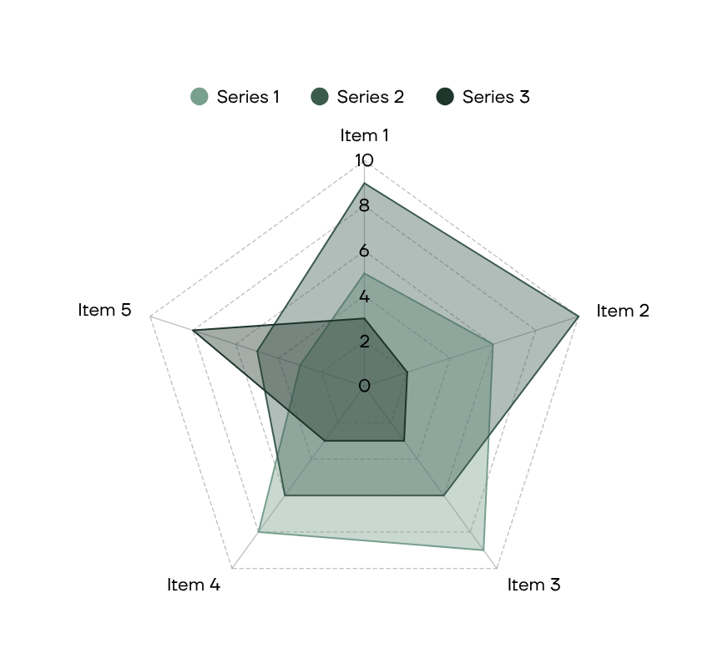
EMPLOYEE DASHBOARD
87%
AVERAGE SALES TARGET ACHIEVEMENT ACROSS ALL REGIONS.
TOP PERFORMERS EXCEED QUOTA BY 23% MONTHLY.

Slide 11

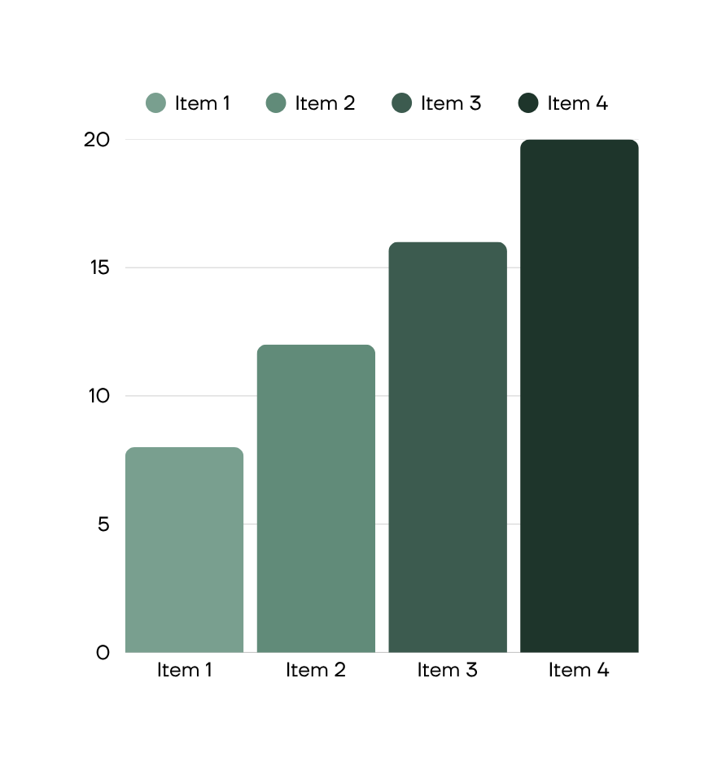
INSIGHTS & FINDINGS
TOP CUSTOMERS :
5 KEY ACCOUNTS
REVENUE SHARE :
68% OF TOTAL
TOP 5 CUSTOMERS DRIVE 68% OF TOTAL REVENUE.
BRAKE SYSTEMS CONTRIBUTE HIGHEST PRODUCT MARGIN AT 34%.
NORTHEAST REGION UNDERPERFORMS BY 22% VS TARGET.

Slide 12


RECOMMENDATIONS
3 KEY ACTIONS
FOCUS ON HIGH-VALUE CUSTOMERS: IMPLEMENT LOYALTY PROGRAMS AND PERSONALIZED ENGAGEMENT STRATEGIES FOR TOP 20% REVENUE CONTRIBUTORS.
OPTIMIZE INVENTORY MANAGEMENT: USE DEMAND FORECASTING TO REDUCE STOCKOUTS AND MINIMIZE EXCESS INVENTORY COSTS.
REDUCE CUSTOMER CHURN: DEPLOY EARLY WARNING SYSTEMS AND PROACTIVE RETENTION CAMPAIGNS FOR AT-RISK ACCOUNTS.

Slide 13


B2B ANALYTICS
DASHBOARD
CONCLUSION
DASHBOARD DELIVERS ACTIONABLE INSIGHTS DRIVING 15% EFFICIENCY GAINS IN SALES OPERATIONS.
NEXT STEPS INCLUDE REAL-TIME DATA INTEGRATION AND PREDICTIVE ANALYTICS EXPANSION.
PHASED ADOPTION ROADMAP ENSURES SEAMLESS TRANSITION ACROSS ALL B2B SALES TEAMS.

